Slide 1
ANG Banking
By: Garrett, Aiden, and Nate

Slide 2
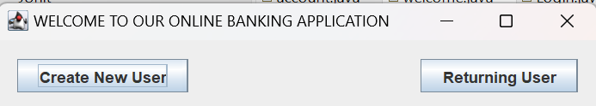
Overview of our Program
Simple banking application
Deposit/Withdrawal/Transfer
Create new account and login
Designed with straightforward ideas
Language used: Java with Java Swing
Good practice with using GUIs and databases

Slide 3
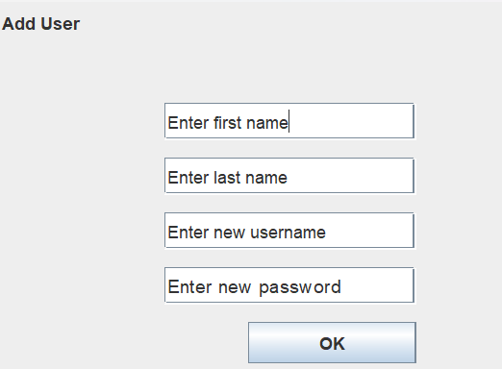
Target Audience
Small businesses
Need more security
Would need to be way more in depth
Users that want to run a banking simulation
Could be for parents/kids that want to develop an understatement in finances

Slide 4
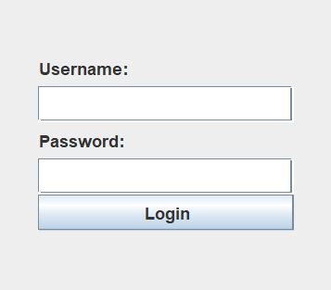
What are members worked on
Nate- Different GUI design and application/functionality
Garret- GUI design, application, database implementation
Aiden- Database implementation with GUI design as well

Slide 5
Demo
https://github.com/natebrosio/CS380FinalProject.git

Slide 6
Positives
Communication with each other
GUI design
Labs helped us a lot with understanding
All had the same idea in mind

Slide 7
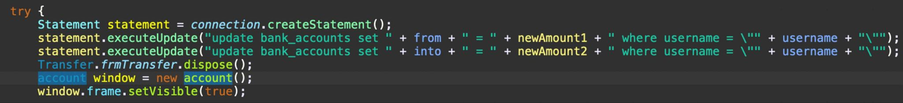
Negatives
Transferring method and pulling from database at first
Different button/label implementations
Wanted to add more functions/better design but time constraint

Slide 8
Questions?

